Slide 1
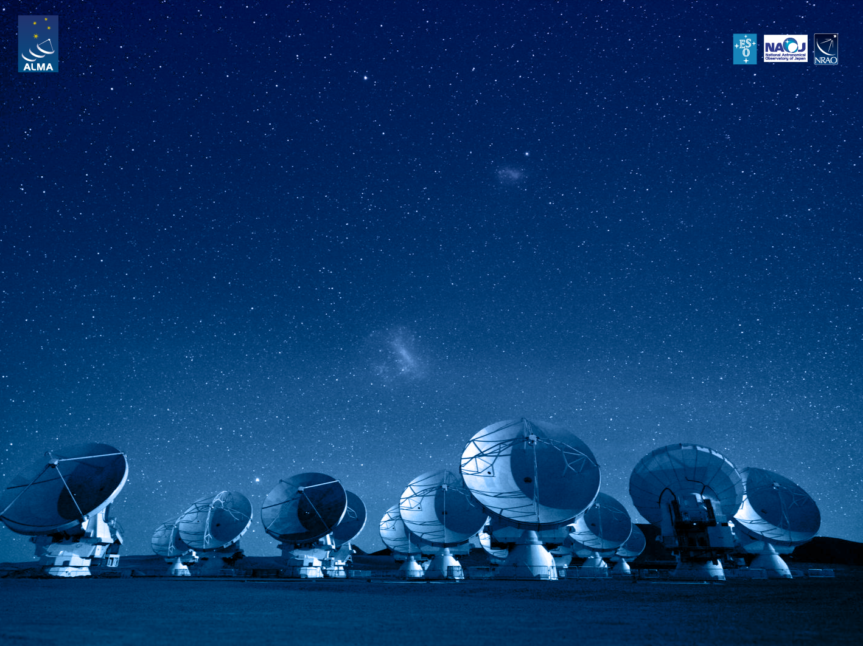
ALMA Common Software Basic Track
Software Engineering Basics

Slide 2
Software Module
Set of related files grouped together in a directory structure
Includes
Makefile
Implementation files (classes)
Unit tests
Usually, a single component is stored in a single software module

Slide 3
Directory Structure
<module>/idl Generic interface definition
<module>/include Language specific header files (C++)
<module>/src Source code
<module>/lib Application/test code libs*
<module>/bin Executables*
<module>/test Test code (separated from app. code)
(*) Populated by the Makefile

Slide 4
ACS Makefile
Project wide set of rules, centrally managed: $ACSROOT/include/acsMakefile
Each developer has to add only the module specific part → file names
Based on a normal Makefile
Strictly correlated to the environment variables and software module standards

Slide 5
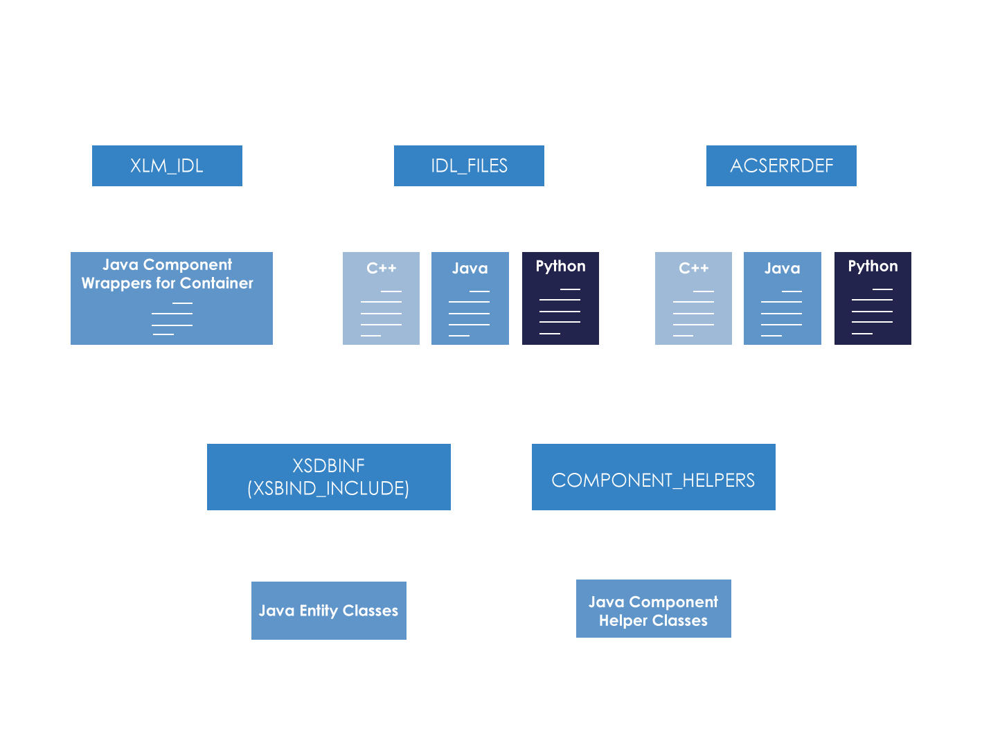
ACS Makefile: file sources and products

Slide 6
Test directory
Place for all module specific test files
Contains its own Makefile
Usually contains a small CDB for component testing (deployment example)

Slide 7
ACSROOT
Default location of installed ACS binaries and libraries
Directory structure similar to module structure
Reference through the $ACSROOT environment variable
Populated during build, if no INTROOT defined
Convention: do not overwrite it, use an INTROOT instead (next slide)

Slide 8
INTROOT
Location for binaries and libraries for system parts under development
Directory structure almost identical to ACSROOT
Reference through the $INTROOT environment variable
Populated through Makefile build (make install)

Slide 9
getTemplate utility
Tool to create ACS directory structures
Also provides templates for files according to SE standards
Makefile
C++ headers and sources
…
Executables: getTemplate, getTemplateForDirectory

Slide 10
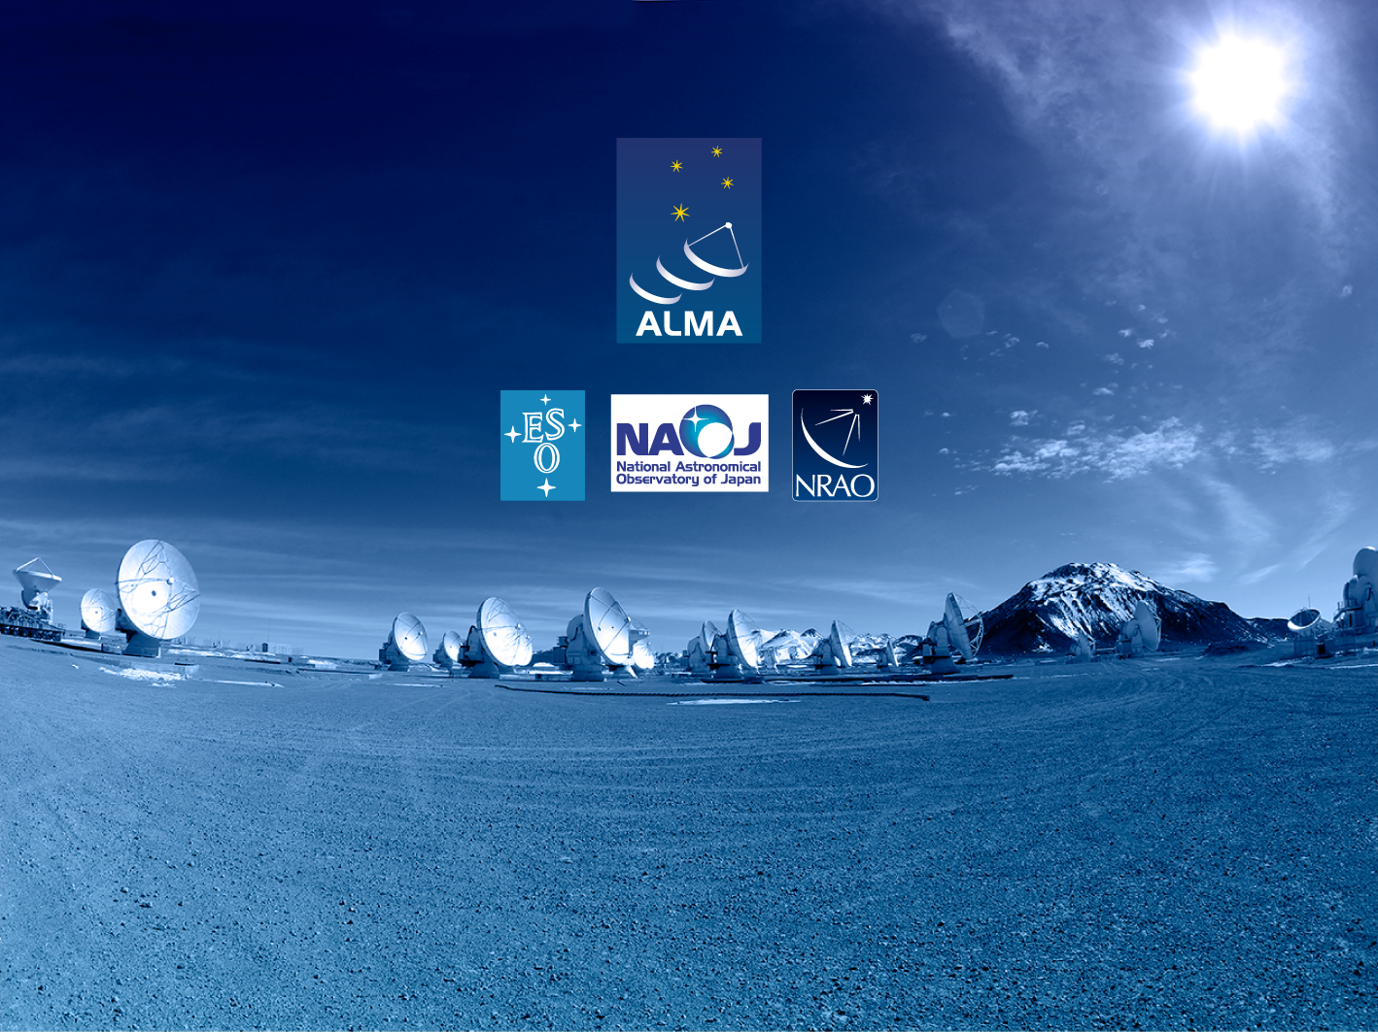
Questions?
Acknowledgements
ACS presentations were originally developed by the ALMA Common Software development team and has been used in many instances of training courses since 2004. Main contributors are (listed in alphabetical order): Jorge Avarias, Alessandro Caproni, Gianluca Chiozzi, Jorge Ibsen, Thomas Jürgens, Matias Mora, Joseph Schwarz, Heiko Sommer.
The Atacama Large Millimeter/submillimeter Array (ALMA), an international astronomy facility, is a partnership of Europe, North America and East Asia in cooperation with the Republic of Chile. ALMA is funded in Europe by the European Organization for Astronomical Research in the Southern Hemisphere (ESO), in North America by the U.S. National Science Foundation (NSF) in cooperation with the National Research Council of Canada (NRC) and the National Science Council of Taiwan (NSC) and in East Asia by the National Institutes of Natural Sciences (NINS) of Japan in cooperation with the Academia Sinica (AS) in Taiwan. ALMA construction and operations are led on behalf of Europe by ESO, on behalf of North America by the National Radio Astronomy Observatory (NRAO), which is managed by Associated Universities, Inc. (AUI) and on behalf of East Asia by the National Astronomical Observatory of Japan (NAOJ). The Joint ALMA Observatory (JAO) provides the unified leadership and management of the construction, commissioning and operation of ALMA.

